Slide 1
Assessments Attitudes of UK Teachers & Parents
Image by Lucy Vigrass
A report prepared by BritainThinks
20 June 2016
Presentation Title Arial Bold 7 pt
1

Slide 2
Background and methodology
BritainThinks conducted an online survey of 506 respondents between 2nd and 15th June 2016, breaking down as:
256
200
50
Parents
Teachers
Head teachers
All with children aged 4-18
With a spread of those with primary and secondary school children
Good mix of genders and regional spread across England
All engaged in teaching full-time (i.e. no TAs or student teachers)
Equally split across primary and secondary school education
Good regional spread across England
All employed at head teacher / deputy head teacher / principal level
Equally split across primary and secondary school education
Good regional spread across England
Please note that the sample size for head teachers in particular is relatively small and as such subgroup differences should be treated as indicative rather than definitive.
Assessments Survey

Slide 3
Summary of background attitudes
1
Assessments, testing and examinations are perceived to be one of the top issues facing the education sector. This concern is shared by parents and teachers alike.
2
Spontaneous associations with testing and assessments are much more likely to be negative than positive, with both teachers and parents associating assessments strongly with ‘stress’ and ‘pressure’.
3
When asked what are the specific issues with testing and assessments, teachers in particular describe concern about the ‘culture’ of testing and assessments having a negative impact on teachers and students. Parents are less likely than teachers to identify this challenge.
4
Evaluation of teacher performance being too closely tied to tests and assessments is not teachers’ most front of mind concern when they think about tests and assessments. However, when asked outright, there is very strong agreement among teachers that the evaluation of teacher performance is too closely tied to tests and assessments.
Assessments Survey

Slide 4
Tests, assessments and examinations are second most likely to be selected as one of the top issues facing the education sector
Total
Second to teacher workload (mentioned by 36% of respondents as one their top two issues for the sector)
Just ahead of funding cuts to schools (mentioned by 30% of respondents as one of their top issues for the sector)
36%
31%
30%
23%
22%
19%
17%
8%
7%
5%
Percentage of Total Respondents Selecting Each Issue from a List
% Selected as a Primary Issue
% Mentioning as a Secondary Issue
% in bold represents total mentioning as a Primary or Secondary Issue
Q3: What do you think are the main issues facing education in England? This could be from first-hand experience of the education sector, or from your impressions or media coverage. Please select up to two issues. Base: All respondents including parents and teachers (n=506)
Assessments Survey

Slide 5
This concern is shared by both the teacher and parent audiences surveyed
Teachers and parents are more or less equally likely to select tests, assessments and examinations as one of their top two issues for the sector
In contrast, there are big divergences between teachers and parents in levels of concern about teacher workload, funding cuts and class sizes
Teacher Responses vs Parent Responses
% of Teachers Selecting as a Primary or Secondary Issue
% of Parents Selecting as a Primary or Secondary Issue
Q3: What do you think are the main issues facing education in England? This could be from first-hand experience of the education sector, or from your impressions or media coverage. Please select up to two issues. Base: All teacher respondents including head teachers (n=250) and parent respondents (n=250)
Assessments Survey

Slide 6
But head teachers are slightly less likely than teachers overall to select tests, assessments and examinations as one of their top issues
A quarter of head teachers surveyed select tests, assessments and examinations as one of their top two issues for the education sector
However, head teachers are more likely to prioritise school performance and accountability as an issue for the sector
Head Teacher responses vs Non-Head Teacher Responses
% of Head Teachers Selecting as a Primary or Secondary Issue
% of Non-Head Teachers Selecting as a Primary or Secondary Issue
Q3: What do you think are the main issues facing education in England? This could be from first-hand experience of the education sector, or from your impressions or media coverage. Please select up to two issues. Base: All head teacher respondents (n=50) and all non-head teacher respondents (n=200)
Assessments Survey

Slide 7
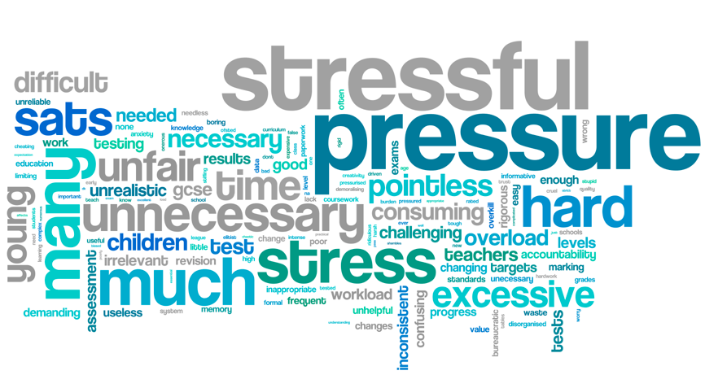
Spontaneous associations with assessments tend to be negative
Common themes across the parent and teacher audiences relate to stress and pressure, the number and difficulty of assessments
Q4: When you think about testing, assessments and examinations in schools in England specifically, what are the first three words or phrases that come to mind? Base: All respondents including parents and teachers (506)
Assessments Survey

Slide 8
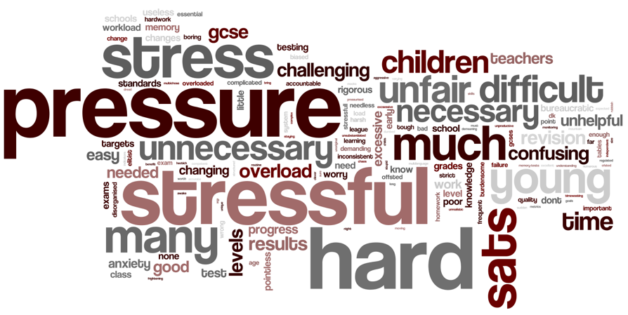
Among parents only, the themes of pressure and stress continue to dominate
But there is greater emphasis on the difficulty of assessments among parents
Associations including ‘hard’ and ‘difficult’ grow significantly in prominence when looking at the parent audience only
Q4: When you think about testing, assessments and examinations in schools in England specifically, what are the first three words or phrases that come to mind? Base: All parent respondents only (n=256)
Assessments Survey

Slide 9
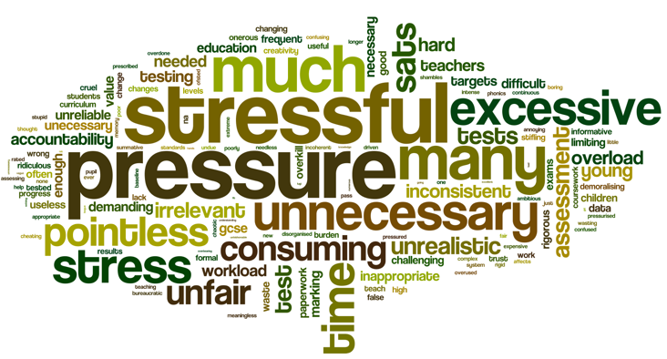
Teachers only are also most likely to associate assessments with stress and pressure
But teachers are more likely than parents alone to focus on the number of assessments compared to parents, and the value of those assessments
With associations including ‘(too) much’, ‘(too) many’ and ‘excessive growing in prominence
As do associations including ‘unnecessary’ and ‘pointless’
A small proportion of teachers mention ‘targets’ spontaneously when thinking about assessments
Q4: When you think about testing, assessments and examinations in schools in England specifically, what are the first three words or phrases that come to mind? Base: All teacher respondents only (n=250)
Assessments Survey

Slide 10
When asked about specific issues related to testing, respondents are most concerned that tests ‘do not reflect students’ achievements’
The ‘impact of the culture of testing on the quality of teaching’ is second most likely to be selected as the top issue related to assessments (with 38% of all respondents selecting it as among their top two issues)
The ‘use of tests and assessments to evaluate teacher performance’ is, comparatively, less likely to be mentioned (at 21%)
Total
47%
38%
35%
22%
21%
15%
8%
8%
4%
2%
Percentage of Total Respondents Selecting Each Issue
% Selecting as a Primary Issue
% Selecting as a Secondary Issue
% in bold represents total mentioning as a Primary or Secondary Issue
Q5: Some people say that ‘tests, assessments and examinations’ are one of the main issues facing education in England. What do you think are the most important concerns related to tests, assessments and examinations that make this an issue for the education sector? Please select up to two issues. Base: All respondents including parents and teachers (n=506)
Assessments Survey

Slide 11
Teachers are much more likely than parents to be concerned about the impact of the ‘culture’ of testing on the quality of teaching
The impact of this growing ‘culture’ of testing is more likely to be selected by teachers as the top specific issue relating to assessments (56%)
Teachers are, unsurprisingly, also much more likely than parents to be concerned about the use of testing to evaluate teacher performance
This option is the third most likely to be selected from the list by teachers
Teacher Responses vs Parent Responses
% of Teachers Selecting as a Primary or Secondary Issue
% of Parents Selecting as a Primary or Secondary Issue
Q5: Some people say that ‘tests, assessments and examinations’ are one of the main issues facing education in England. What do you think are the most important concerns related to tests, assessments and examinations that make this an issue for the education sector? Please select up to two issues. Base: All teacher respondents including head teachers (n=250) and parent respondents (n=250)
Assessments Survey

Slide 12
This finding is consistent across the head teacher and wider teacher sample
Within the teacher sample, secondary school teachers are slightly more likely than primary school teachers to select ‘the impact of the culture of testing and assessment on the quality of teaching’ as the top issue related to assessments (60% compared to 52%)
Secondary teachers are also more likely than primary school teachers to select ‘the use of tests and assessments to evaluate teacher performance as the top testing-related issue (34% vs 26%)
Head Teacher responses vs Non-Head Teacher Responses
% of Head Teachers Mentioning it as a Primary or Secondary Issue
% of Non-head Teachers Mentioning it as a Primary or Secondary Issue
Q5: Some people say that ‘tests, assessments and examinations’ are one of the main issues facing education in England. What do you think are the most important concerns related to tests, assessments and examinations that make this an issue for the education sector? Please select up to two issues. Base: All head teacher respondents (n=50) and all non-head teacher respondents (n=200)
Assessments Survey

Slide 13
There is strong agreement among both parents and teachers that the ‘culture of testing’ is having a negative impact on teachers and students
Percentage of Respondents Who Agree, Disagree, or Don’t Know
% Net Disagree
% Don’t Know / No Opinion
% Net Agree
Q9: Below are a number of things that have been said about testing, assessments and examinations in English schools. To what extent do you agree or disagree with each argument?. Base: All respondents (n=506)
Assessments Survey

Slide 14
And (at 9 in 10) the vast majority of teachers say that their evaluation is too dependent on students’ test results
While a significant proportion disagree that this is the case (37%), almost 3 in 5 teachers say that they are concerned that they may be passing stress about tests and assessments onto their students
Percentage of Respondents Who Agree, Disagree, or Don’t Know
% Net Disagree
% Don’t Know / No Opinion
% Net Agree
Q9: Below are a number of things that have been said about testing, assessments and examinations in English schools. To what extent do you agree or disagree with each argument?. Base: All teachers (250) – except “My head teacher places a lot of pressure on me when it comes to the performance of my students in official tests and assessments”, Base: All Non-head Teachers (200)
Assessments Survey

